Slide 1
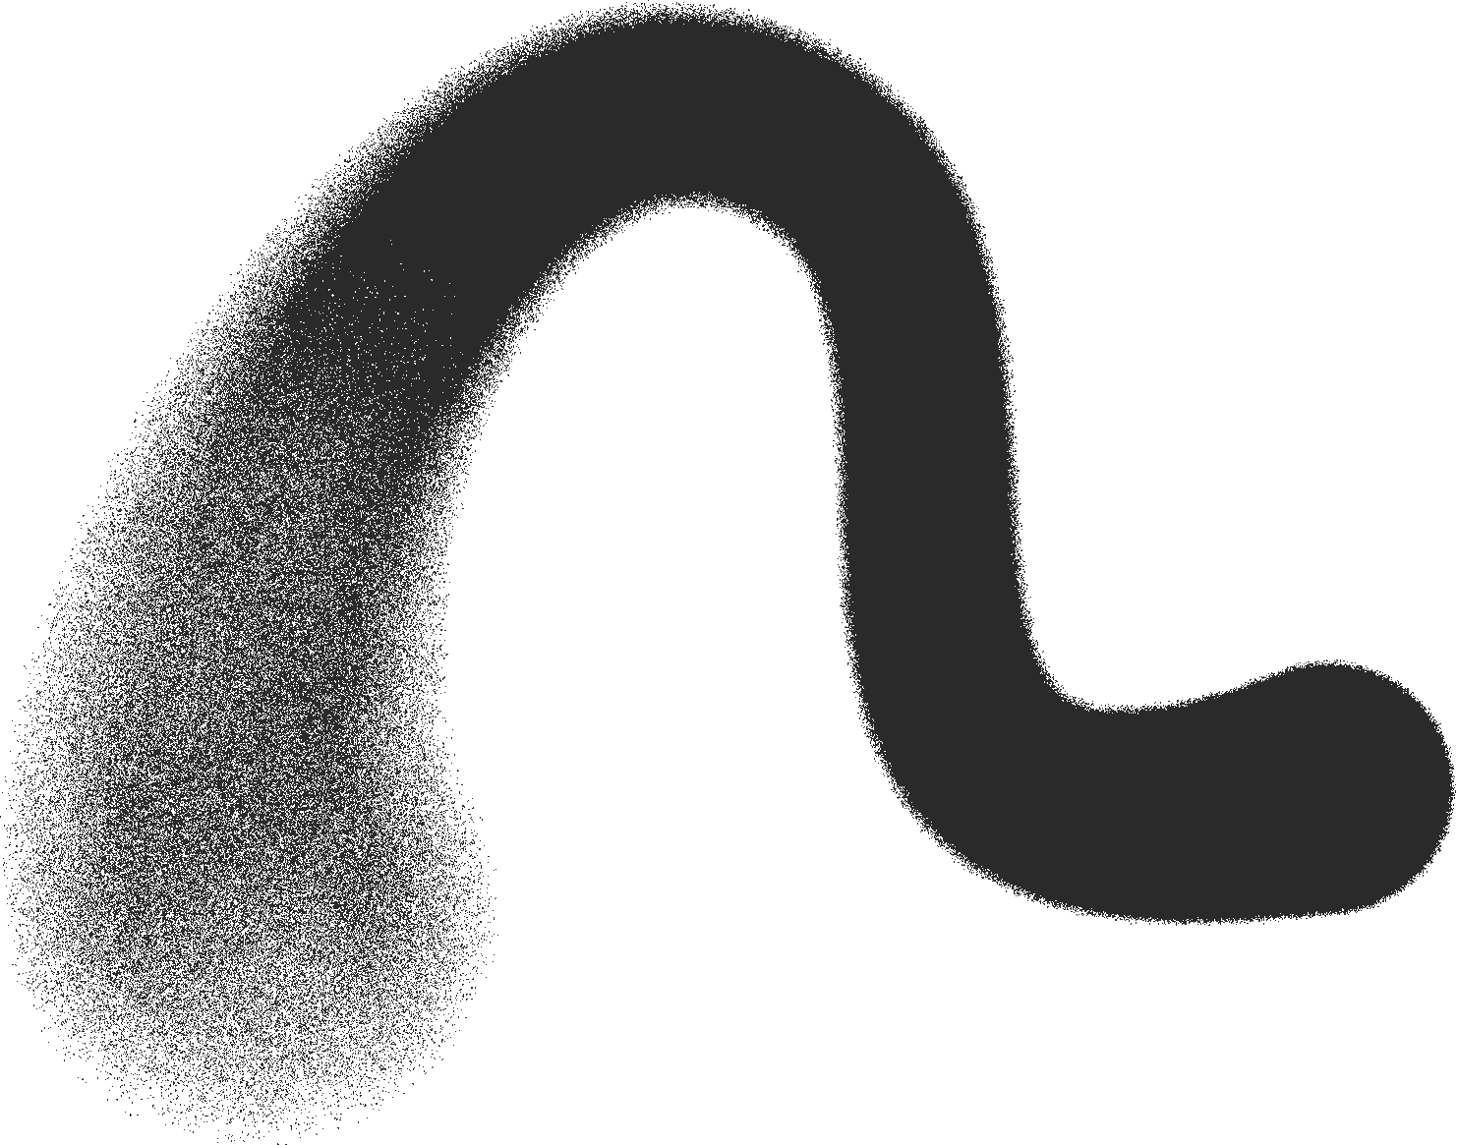


FRAUD PREDICTION
PRESENTED BY:
ABHISHEK KUMAR RAJA SARDAR
RAM GOPE
USING IBM SPSS MODELER

Slide 2



INTRODUCTION
PROJECT GOAL :
To develop, implement, and evaluate a robust machine learning classification model capable of accurately identifying and flagging fraudulent financial transactions to minimize loss and enhance customer trust.

Slide 3
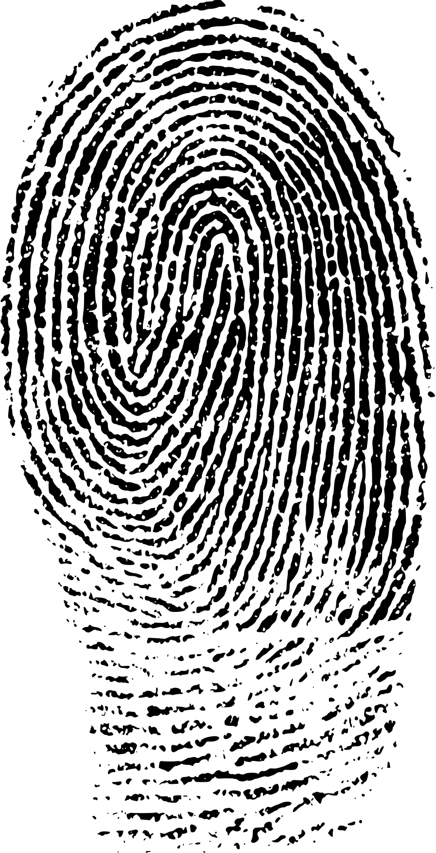

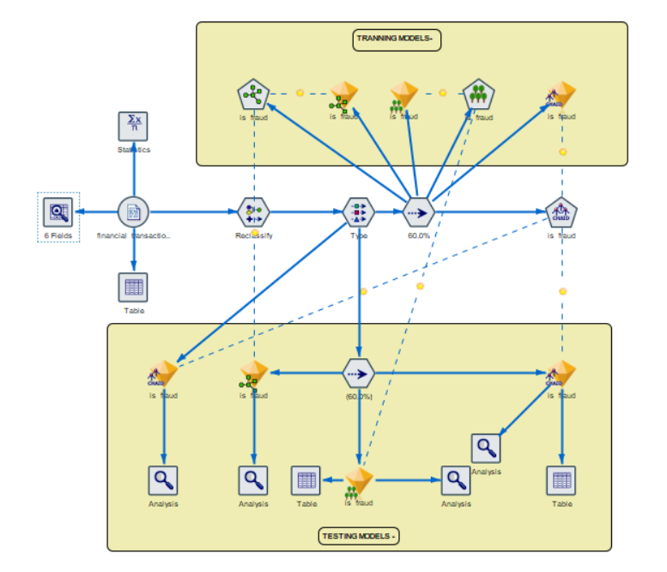

MODELING WORKFLOW IN IBM SPSS MODELER
Covers the CRISP-DM process: Data → Processing → Modeling → Evaluation
Integrated attributes: Evaluating Fraud
Data split into training & testing sets
Built multiple models: Random Forest, CHAID Node ,XGBoost Tree
Added analysis nodes for performance comparison

Slide 4


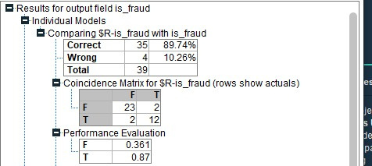
FRAUD DETECTION :
( USING CHAID MODEL )
Our fraud detection strategy is rooted in *anomaly detection theory*, where the goal is to identify transactions that deviate significantly from established patterns. Using the provided financial_transactions.csv dataset, we analyze features such as *transaction amount* and *transaction type* to build our predictive model.
We employ the *CHAID (Chi-squared Automatic Interaction Detector)* algorithm for this purpose. CHAID is a powerful decision tree method that is particularly effective with our data because it can determine the most statistically significant relationships between predictors (like transaction_type) and the outcome (is_fraud).
This process generates a clear set of rules, such as identifying that *'Transfer' transactions are frequently associated with fraud*, allowing us to accurately and transparently flag suspicious activity in real-time.

Slide 5

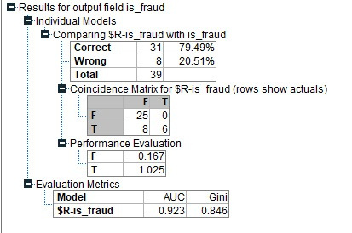
FRAUD DETECTION :
( USING RANDOM FOREST MODEL )
Our approach to fraud detection leverages the power of ensemble learning through a *Random Forest* model. This technique constructs a large collection of individual decision trees, each trained on random samples of our financial_transactions.csv data.
Every tree in the "forest" independently analyzes transaction features, such as the amount and transaction_type, and casts a vote on whether it is fraudulent.
The model's final prediction is based on the majority vote, a democratic process that drastically improves accuracy and robustness, allowing it to effectively identify intricate fraud patterns that a single model might miss.

Slide 6

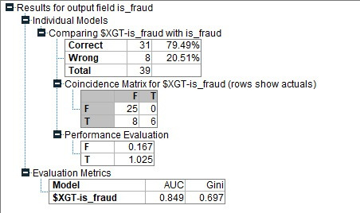
FRAUD DETECTION :
( USING XGBOOST MODEL )
Our fraud detection strategy is centered on the implementation of an XGBoost (Extreme Gradient Boosting) model, a state-of-the-art algorithm renowned for its high predictive accuracy.
By training on our financial_transactions.csv dataset, the model will learn from historical data, analyzing features such as transaction amount, type, and customer behavior patterns.
XGBoost's strength lies in its ability to build a highly robust classifier by combining multiple decision trees, allowing it to uncover complex and subtle indicators of fraudulent activity. This results in a powerful system capable of assigning a risk score to new transactions, enabling the proactive identification and prevention of fraud.

Slide 7





Presentation
THANK YOU
ABHISHEK KUMAR
RAJA SARDAR
RAM GOPE

